Slide 1
New Facility Recommendation Tracker (FRT)
July 2019

Slide 2
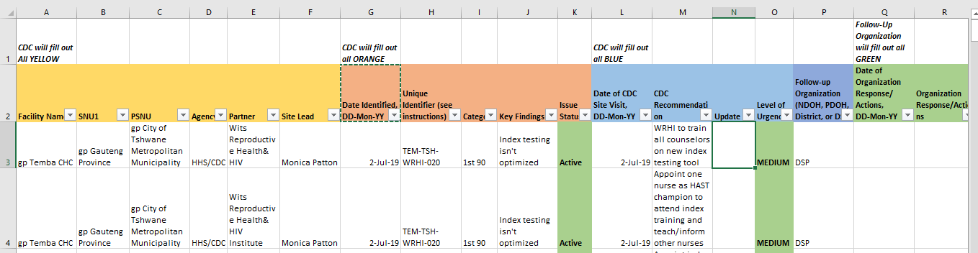
New Facility Recommendation Tracker
All site leads should be using new facility recommendation tracker that looks like this:
All site leads should be using new facility recommendation tracker that looks like this:
Locations:
S:\Share\_Siyenza\Resources\12 - Site Lead - Facility Recommendation Tracker
GitHub
Facility Recommendation Tracker, July 2019

Slide 3
Facility Recommendation Tracker
Submitted each Monday
Used to create weekly, merged Facility Recommendation Tracker
Contains all active issues from all facilities
Sent to DSPs and NDOH
Automatic program will pull all active issues
From site leads’ folders on share drive
FIRST TIME YOU USE IT:
Please copy and paste all active/current issues from previous Facility Recommendation Tracker to the new Facility Recommendation Tracker
Facility Recommendation Tracker, July 2019

Slide 4
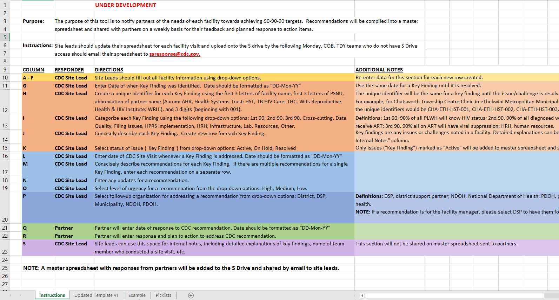
Four Tabs
First Tab: Instructions
Facility Recommendation Tracker, July 2019

Slide 5
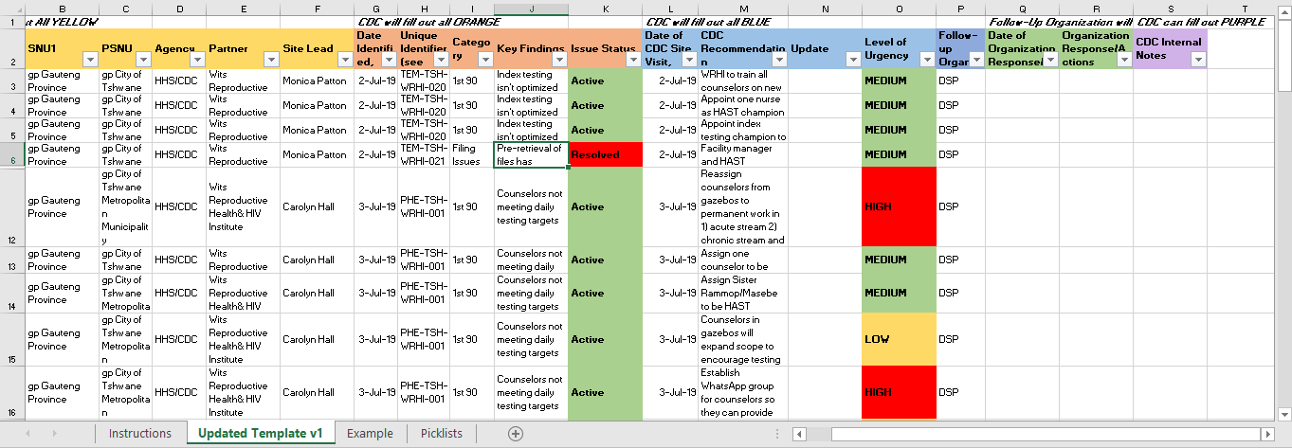
Four Tabs
Second Tab: The Tracker (Updated Template v1)
Facility Recommendation Tracker, July 2019

Slide 6
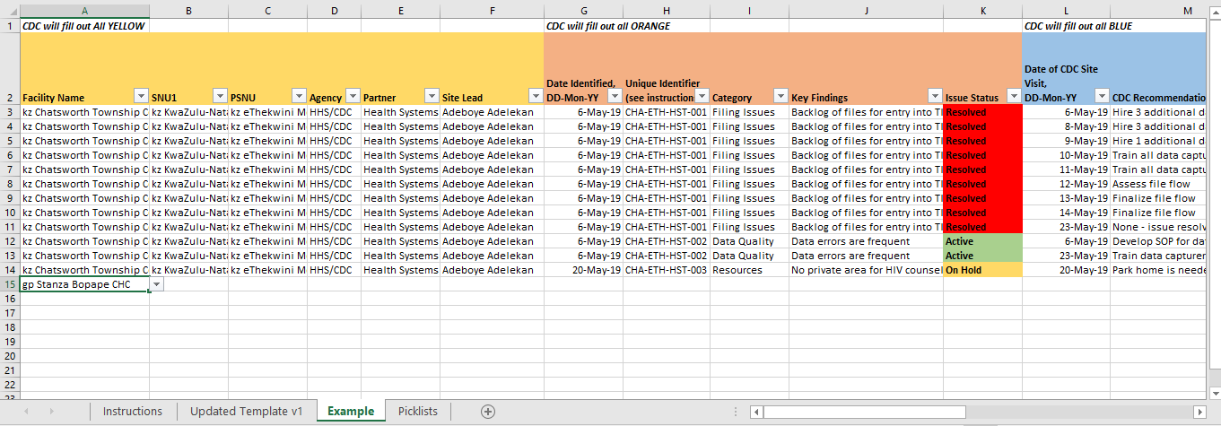
Four Tabs
Third Tab: Example
Facility Recommendation Tracker, July 2019

Slide 7
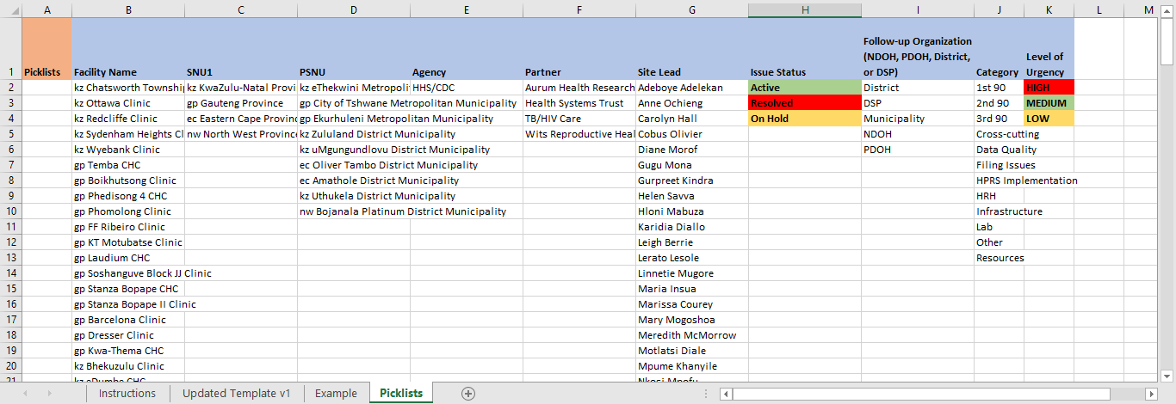
Four Tabs
Fourth Tab: Picklists used to create drop-down lists
Need to be updated occasionally
Contact Monica Patton (gnh9@cdc.gov) to add to the picklists
Facility Recommendation Tracker, July 2019

Slide 8
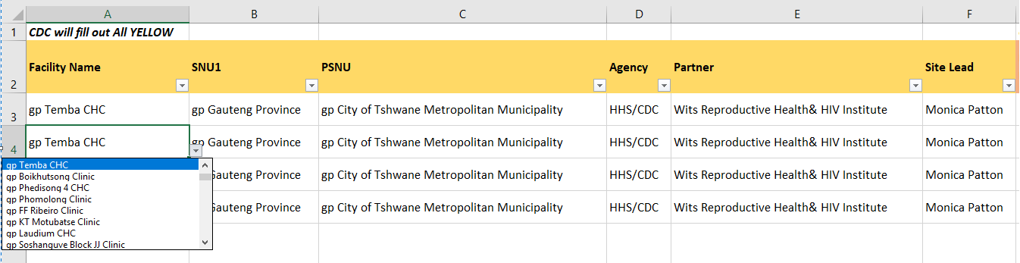
Helpful hints
Drop-down lists
Keyboard shortcut: ALT-↓(down arrow) to bring list up, then use ↓ ↑ Page Up or Page Down to move through list
Lists come from picklists on fourth tab
Can copy/paste entire rows
No need to re-type everything
Facility Recommendation Tracker, July 2019

Slide 9
Yellow Section – Facility Information
Basic facility information
Drop-down lists
Facility Recommendation Tracker, July 2019

Slide 10
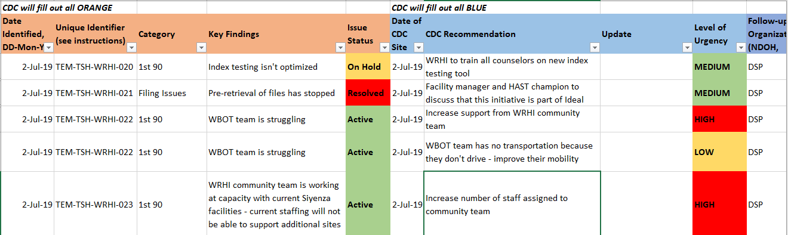
Orange/Blue Sections – Key Findings/Recommendations
Date when problem first identified – does not change
Facility Recommendation Tracker, July 2019

Slide 11
Orange/Blue Sections – Key Findings/Recommendations
Unique identifier for each Key Finding
First 3 letters of facility name
First 3 letters of PSNU
Abbreviation of partner name (Aurum: AHR, Health Systems Trust: HST, TB HIV Care: THC, Wits Reproductive Health & HIV Institute: WRHI)
3-digit number (beginning with 001)
Facility Recommendation Tracker, July 2019

Slide 12
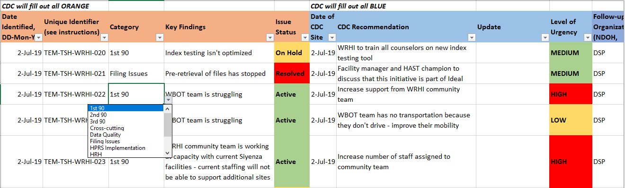
Orange/Blue Sections – Key Findings/Recommendations
Best estimate of which category the key finding/issue is related to
1st 90
2nd 90
3rd 90
Cross-cutting
Data Quality
Filing Issues
HPRS Implementation
HRH
Infrastructure
Lab
Other
Resources
Facility Recommendation Tracker, July 2019

Slide 13
Orange/Blue Sections – Key Findings/Recommendations
Key Finding/issue identified to be addressed
Facility Recommendation Tracker, July 2019

Slide 14
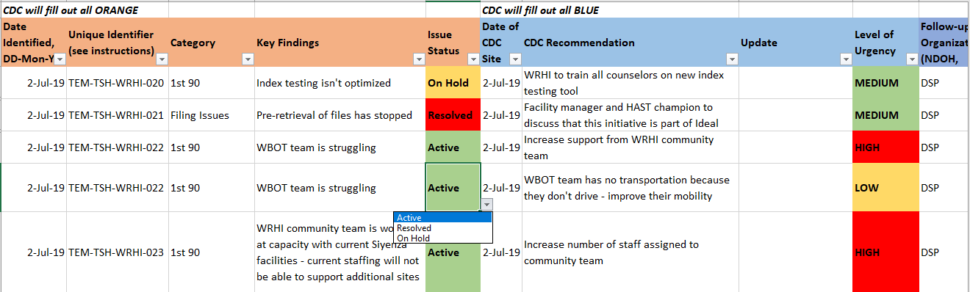
Orange/Blue Sections – Key Findings/Recommendations
Overall status of key finding/issue (not of each recommendation)
Active
Resolved
On Hold
Facility Recommendation Tracker, July 2019

Slide 15
Orange/Blue Sections – Key Findings/Recommendations
Recommendations to address each key finding
One recommendation per row (new recommendation = new row)
Multiple recommendations for same key finding = multiple rows with same unique identifier
Do not delete/change recommendations
Update status to indicate no longer relevant
Facility Recommendation Tracker, July 2019

Slide 16
Orange/Blue Sections – Key Findings/Recommendations
Date of CDC visit when key finding/issue and recommendation were discussed/created
Can be changed to reflect the date it was most recently addressed
Facility Recommendation Tracker, July 2019

Slide 17
Orange/Blue Sections – Key Findings/Recommendations
Updates related to each specific recommendation; can note if recommendation has been completed or no longer valid
Facility Recommendation Tracker, July 2019

Slide 18
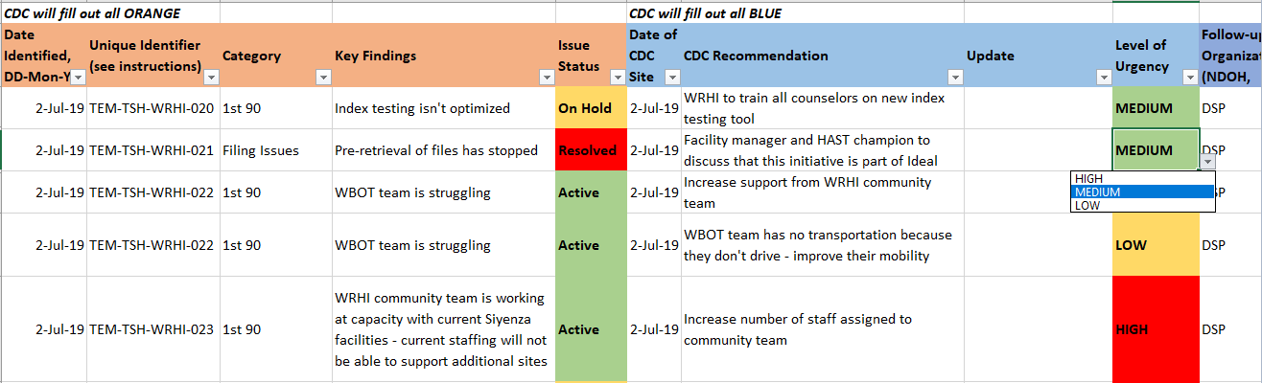
Orange/Blue Sections – Key Findings/Recommendations
Drop-down list for urgency of each recommendation
High
Medium
Low
Facility Recommendation Tracker, July 2019

Slide 19
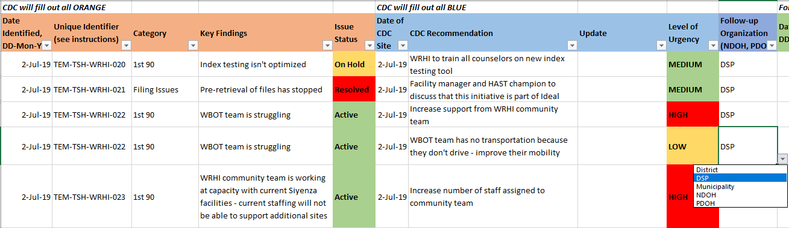
Orange/Blue Sections – Key Findings/Recommendations
Organization responsible for addressing that recommendation
District
DSP
Municipality
NDOH
PDOH
Facility Recommendation Tracker, July 2019

Slide 20
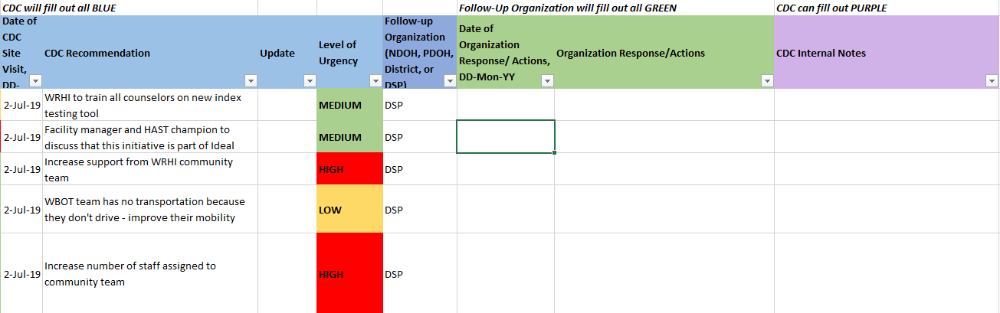
Green/Purple Sections – Follow-Up/Notes
Follow-up organizations can indicate date and response/actions
Facility Recommendation Tracker, July 2019

Slide 21
Green/Purple Sections – Follow-Up/Notes
Site leads can write notes that will remain internal and will not be included in weekly reports
Facility Recommendation Tracker, July 2019

Slide 22
Submission
Submit each Monday by 16:00
Save file with name “Facility Recommendation Tracker”
Do not change file name to ensure automatic script can run
When possible, save to your folder on Share drive
S:\Share\_Siyenza\Data Collection Tools\Your_Name_Here
Otherwise, send to zaresponse@cdc.gov
If it’s not received by 16:00 on Monday, email will be sent to you and supervisor
Please respond to email to indicate if no site visits were performed
Facility Recommendation Tracker, July 2019

Slide 23
Questions?
Monica Patton
gnh9@cdc.gov
0825244206
Facility Recommendation Tracker, July 2019

